Slide 1
Machine Unlearning
Mattia Castaldo 1837100
Matteo Migliarini 1886186
Nemish Murawat 2056142
Javier Martinez 2058968
Statistical Learning
Sapienza University of Rome

Slide 2
Table of contents
Introduction and Formalization
Random Perturbation
Stochastic Teacher Network
Fisher Masking
Selective Synaptic Dampening
Conclusions and Comparison

Slide 3
Machines can learn. Can they Forget?
Removing the influence of a particular subset of the training data within a model has several important applications:
Follow GDPR regulation (right to be forgotten).
Pursue Ethical ML (forget discriminatory information).
Combat Cybersecurity attack (data poisoning, malicious data).
The naive approach, commonly referred as exact unlearning, involves retraining the model from scratch, without including that subset of the data that needs to be forgotten.
In our project, we explore the main methods of what is known as approximate unlearning, which tackles this task in a more efficient way, avoiding this computationally expensive and time-consuming retraining steps, while aiming to preserve most of the accuracy on the remaining data.
Machine Unlearning

Slide 4
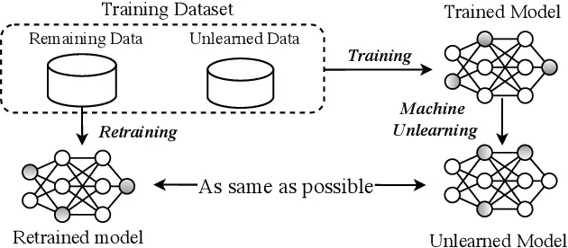
Problem formalization
Let us consider a machine learning model M that has been trained on dataset D. The training set D is then divided into two partition subsets: D_{forget} : data points whose influence needs to be removed from the model. And D_{retain}: data points that are still needed to be remembered.
Let’s now consider an unlearning model M_{naive} which naively performs untraining by retraining only on D_{retain} . The overall goal of approximate machine unlearning is to obtain a new model M_{unlearn} as aligned as possible to M_{naive} , by applying an unlearning method to M (pretrained model).
Machine Unlearning

Slide 5
Class vs Random subset unlearning
In the papers we read, the unlearning target wasn't always defined in the same way, sometimes papers referred to the unlearning target as whole classes and sometimes as single data points. Here we formalize this as two different tasks:
Class unlearning: refers to forgetting a subset of classes {C₁ ,...,C_{n} } previously learned by a classification model. For example removing the data of the class “Dog” from a model distinguishing among pictures of animals.
Random Subset unlearning: refers to forgetting a particular subset of data points {x₁ ,...,x_{n} } which have already been learned by a model. For example, removing a particular user's data who has asked to be forgotten (GDPR).
Machine Unlearning

Slide 6
Machine Unlearning Methods

Slide 7
Baseline:
Fine Tuning
As the simplest possible solution to this problem which doesn't involve retraining the network from scratch we could just train again the model for a few epochs with only the D_{r} set.
It's a known fact that this DNN after a while will incur in what is known as "catastrophic forgetting", with which we hope that the network will be able to actually forget about the samples in D_{f}.
This model is the simplest possible, and as you can expect isn't the most effective, but all the models that we're going to see from now on actually use this method as a second step.
Machine Unlearning

Slide 8
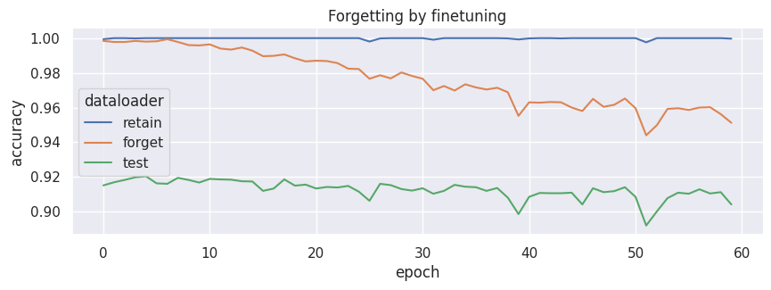
Catastrophic Forgetting
Finetuning on D_{r}.
LR = 10⁻⁵
lambda = 0.01
We can see the results of fine-tuning after several epochs and observe the performance of the model degrade on the forget set as it starts aligning with the performance on test set.
Machine Unlearning

Slide 9
Random Perturbation
This algorithm is just a slight improvement over the baseline algorithm.
The concept is that we’re going to slightly perturb all the parameters such that the model parameters will be moved out of the local optima, and then we're going to perform a few epochs of retraining in order to bring the model to a new local optima, one in which it hopefully forgot about D_{f} .
Machine Unlearning

Slide 10
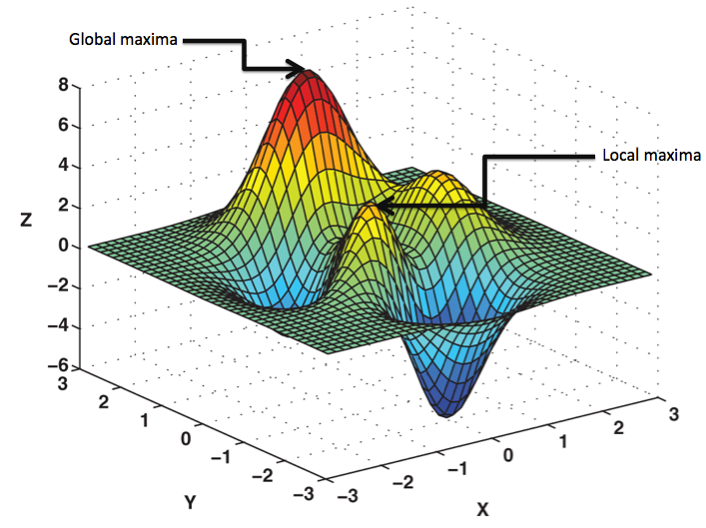
Random Perturbation: algorithm
For each layer of the model we generate a matrix with random values distributed as N(0, βσ) where σ is the standard deviation of the learned parameters for that layer, and β is an hyperparameter that regulates how strong should be the noise.
Note that the perturbation phase of this algorithm is blazing fast, being O(N) where N is the number of learned parameters.
One of the peculiarities of this simple algorithm is that it’s one of the few methods capable of forgetting without the need of using the D_{f}, so that it’s well suited for those cases in which it’s not feasible to fetch the forget set.
Machine Unlearning

Slide 11
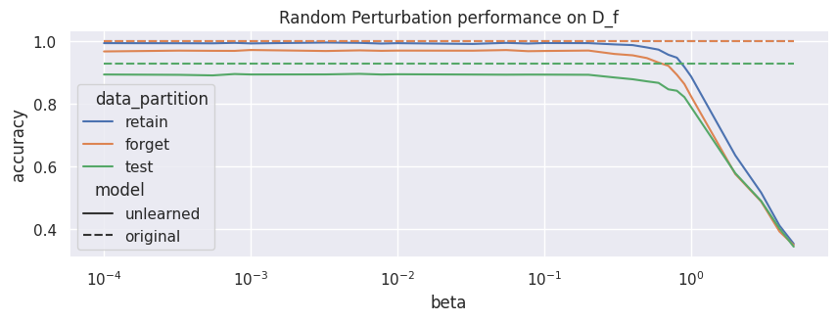
Random Perturbation: Beta
Performance for different β values, evaluated on 5 fine-tuning epoch
When considering the performance of this algorithm with varying betas we can see how the performance decreases (as expected) with the increase of β, and we also notice how the D_{test} and D_{r} performances remain close enough to the original performance, while the D_{f} performance is closer to the D_{test} performance, even though not by much.
Machine Unlearning

Slide 12
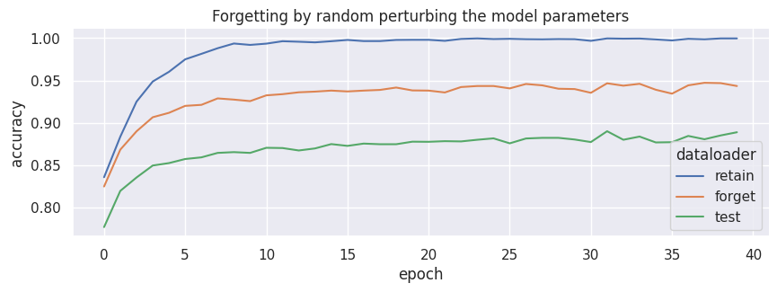
Random Perturbation: Epochs
When considering how this method compares to the Only Fine-tuning method we can see how all the performances are way worsened at epoch 0, but then the model is able to recover its original performance on D_{r} and on D_{Test}. At the same time we see that the model did forget something about D_{f} although not completely, but when accounting with the simplicity of this model, this is still an impressive result.
Accuracy for the noise-perturbed model for each retrained epoch.
β = 0.7, lr =10−5, λ = 0.01
Machine Unlearning

Slide 13
Stochastic Teacher
Network
The algorithm has two stages:
1) In the stage of knowledge erasure, the goal is to erase the relevant impact of forgotten data D_{forget} on the original model.
2) We use the remaining data D_{retain} and the original model to help the unlearned model to restore the performance with respect the retained data.
Machine Unlearning

Slide 14
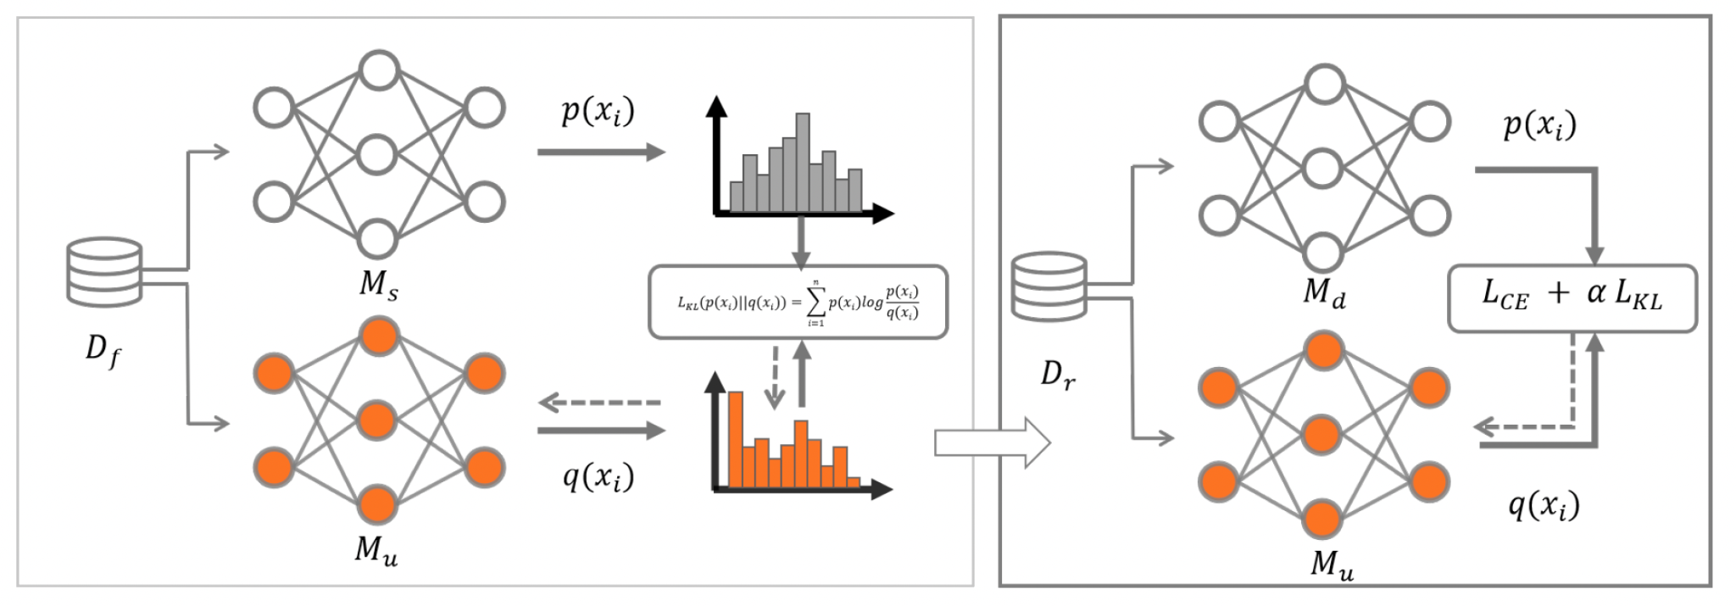

Stochastic Teacher Network: algorithm
Knowledge erasure:
1) We use the parameters of the original model to initialize Mu, while Ms is randomly initialized ( does not contain any information on Df)
2) Compute the disparity in probability distributions between the two models with respect to Df by Kullback-Leibler Divergence (KLD):
Reconstruction:
Use the remaining dataset Dr and the original model to help Mu to restore its performances. 1) Compute the KLD the original model and Mu 2) Compute the Cross entropy loss for Mu on Dr. The total loss is:
Knowledge erasure phase
Reconstruction phase
Machine Unlearning

Slide 15
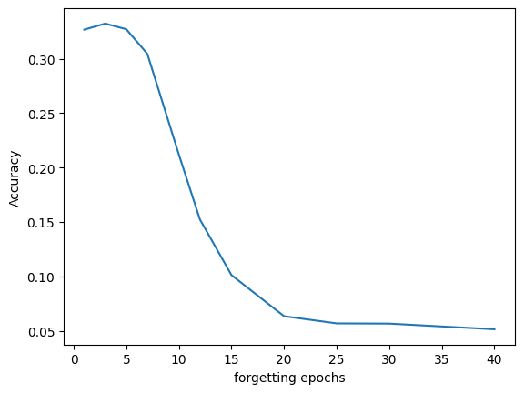
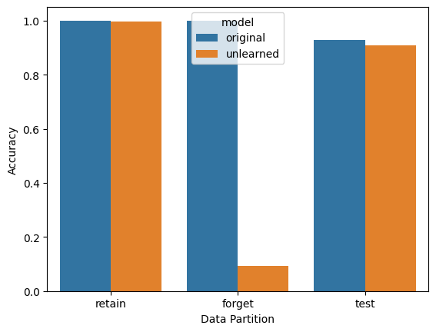
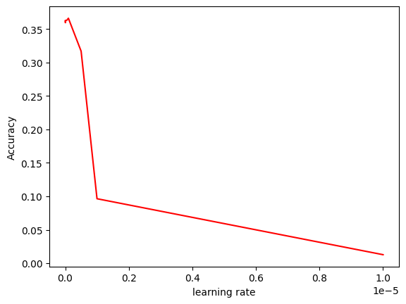
Stochastic Teacher Network
Class Unlearning and limitations

Slide 16
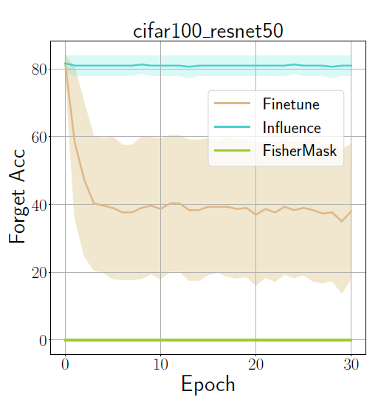
Fisher Masking
The main motivation of the FM unlearning method is that instead of being random, the perturbations of parameters should be biased towards removing the Forget data artefacts in the network.
These Important parameters are identified and then perturbed with the help of the Fisher Information Matrices of D_{forget} and D_{retain} .
Machine Unlearning

Slide 17

Fisher Masking: algorithm
1. Compute the two Fisher Information Matrix (FIM) F_{r} and F_{f} using D_{forget} and D_{retain} datasets.
2. Compute F_{f, jj}− F_{r, jj}, where F_{f, jj} represents how the jth parameter gives information with respect to forget Data (its importance for this dataset).
3. Select the top R % parameters and zero them out from the resulting matrix. Intuitively, we perturb the parameters that have both more information about the Forget Set, and least about the retain set.
Here, R will be considered an Hyperparameter as this would depend on the difficulty of the Dataset and the model used
Machine Unlearning

Slide 18
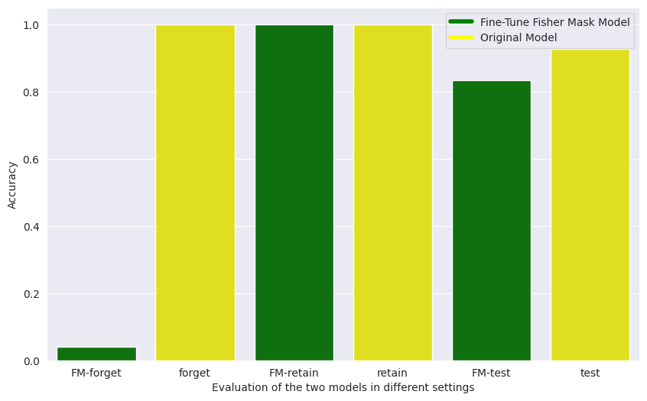
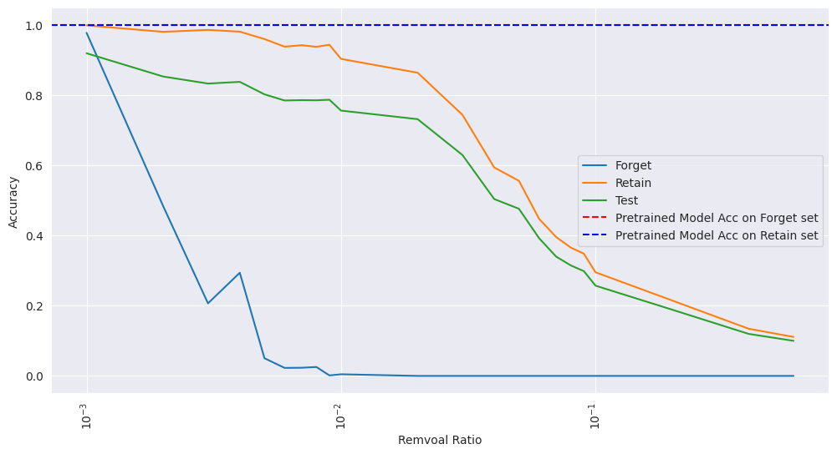
Fisher Masking Class Unlearning
Machine Unlearning

Slide 19
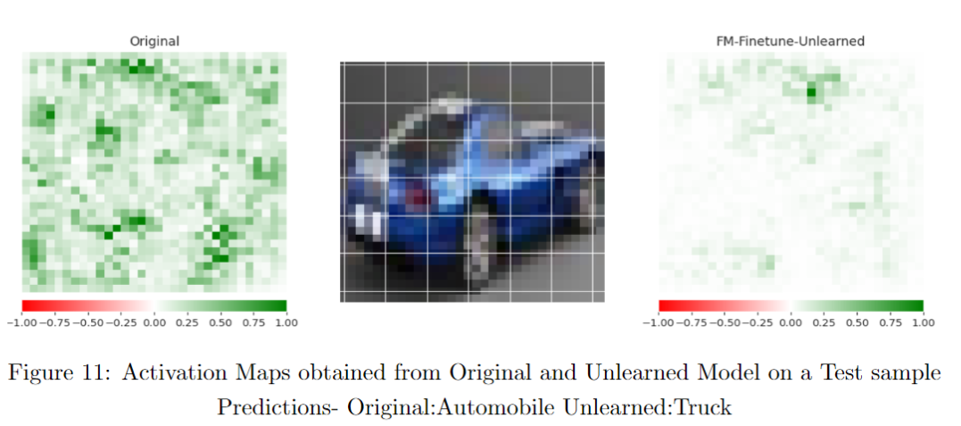
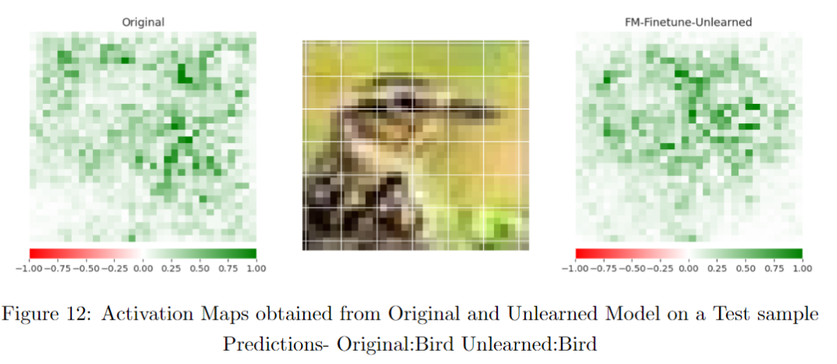
Unlearn Interpretation by Saliency maps
Unlearned class: we can see how much the saliency map differ. In the forgotten sample the model is completely unable to focus on the object of concern.
Retained class: instead the model is still able to somehow focus on the object of concern even after the unlearning process.
Machine Unlearning

Slide 20
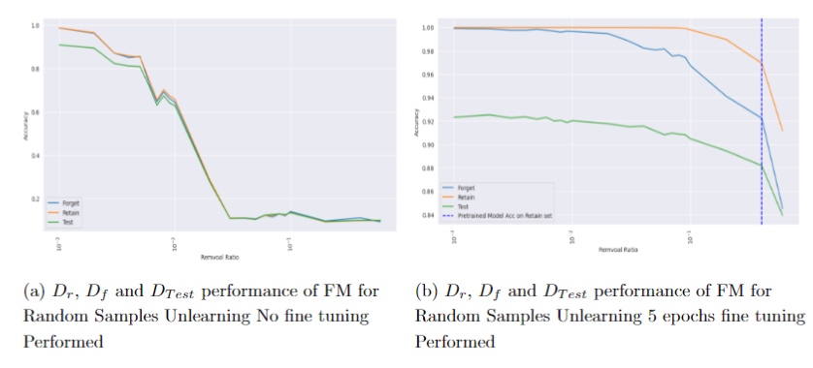
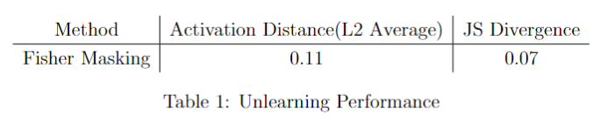
Random Sample
-Difficulty in Selecting Hyperparameter without MIA
-Low Values of JS and Activation signifies closeness of the Probability Distributions
-Generalisation is still maintained
Machine Unlearning

Slide 21
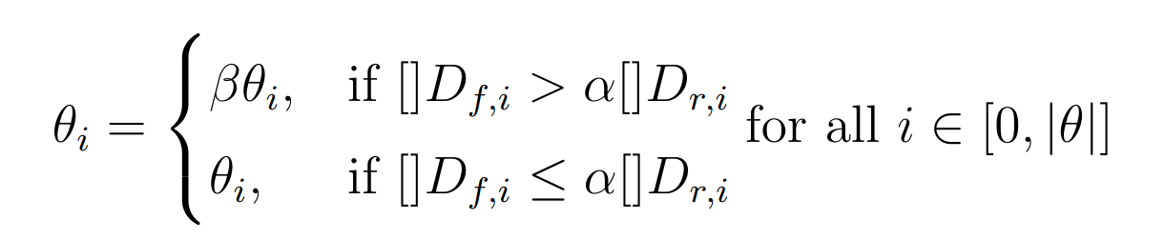
Selective Synaptic Dampening
We leverage the Fisher Information Matrix (or its diagonal) in order to build upon and improve the results of the previous Fisher Masking approach.
The idea is similar: for each learned parameter we estimate how important it is for the D_{f} and for the D_{r}. Then for all parameters we apply:
Improving Fisher Masking with dampening by a factor
meaning that we dampen the parameter by a factor 𝜷 if the parameter importance for the forget set is 𝛂 times higher than the one for the retain set.
Machine Unlearning

Slide 22
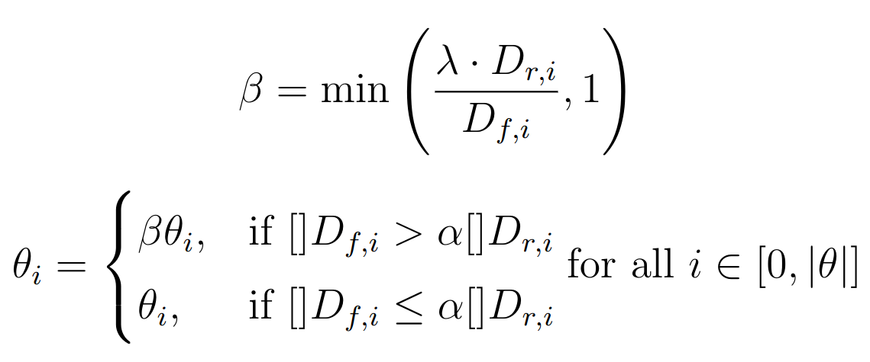
SSD Algorithm
Each learned parameter is dampened by the beta factor, not following an arbitrary top R% threshold cutoff but rather following the comparison bt the relationship between the importance in the forget set and in retain set.
Beta is computed then for each parameter as a function of of the importances for the respective sets, times a lambda hyperparameter. Then is cut off at 1 to prevent unwanted amplification of the given parameter.
Machine Unlearning

Slide 23
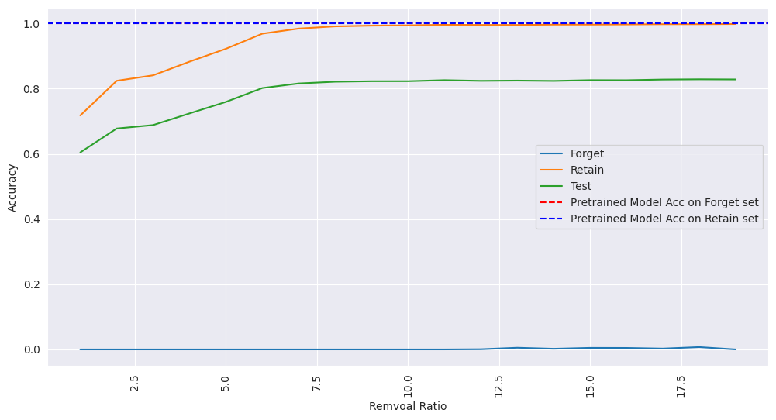
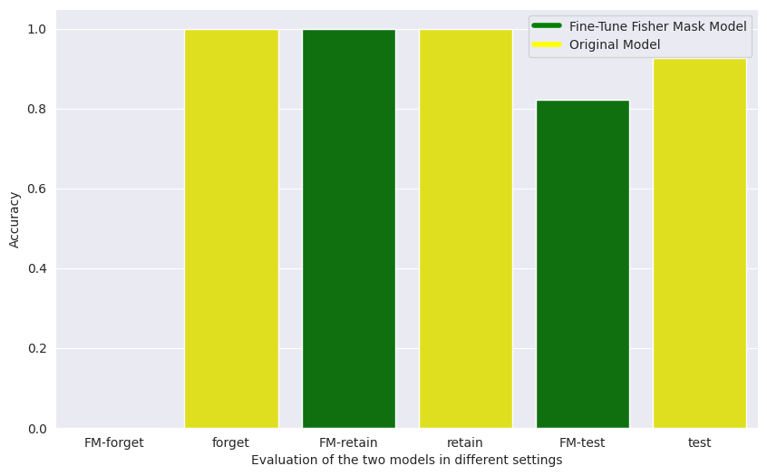
Class Unlearning Performance
When doing class unlearning the results are impressive.
We can see how the forget set is completely forgotten while the memory on retain and test are maintained even without performing any fine-tuning.
Machine Unlearning

Slide 24
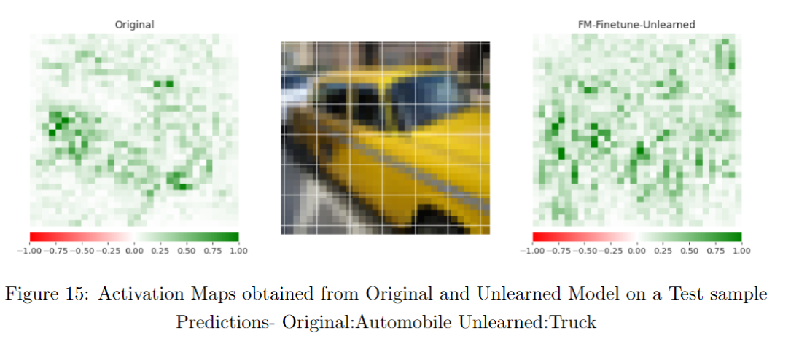
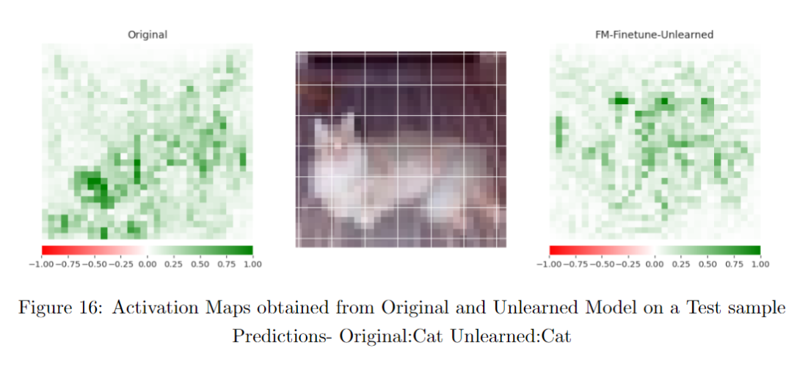
Unlearn Interpretation by Saliency maps
Unlearned class: we can see how much the saliency map differ. In the forgotten sample the model is completely unable to focus on the object of concern.
Retained class: instead the model is still able to somehow focus on the object of concern even after the unlearning process.
Machine Unlearning

Slide 25
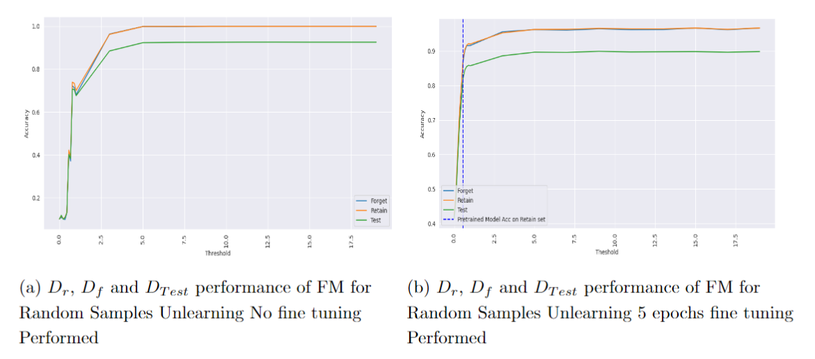
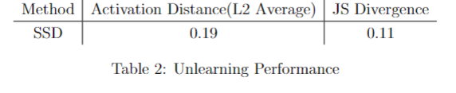
Random Sample
-Difficulty in Selecting Hyperparameter without MIA
-Low Values of JS and Activation signifies closeness of the Probability Distributions
-Generalisation is still maintained
Machine Unlearning

Slide 26
Performances and Conclusions

Slide 27
Performances and Conclusions
Methods
Fine-tuning: Not efficient for Class as well Random Samples Unlearning
Random Perturbation: Works finely, but results could be better for both tasks.
Stochastic Teacher Network: Works well for Class Unlearning. Computationally Expensive.Inefficient for Random Samples
Fisher Masking: Works well for both task. Computational Okay. Hard Constraint of selection and pruning.
Selective-Synaptic-Dampening: Works well for both task. Computationally okay. Refined Constraint and dampening.
Unlearning Tasks
-Class Unlearning: easy to evaluate because a class can be forgotten without directly affecting performance on other classes. Then we can evaluate the unlearned model in the forget, retained and test sets. -Random Samples Unlearning: hard to evaluate since even after unlearning, the model should still predict correctly the forget set due to generalization properties of our model. More sophisticated methods are needed which are computationally expensive (huge reliance on either Retrained Models or MIA attacks).
Machine Unlearning

Slide 28
Thank you for the attention!

Slide 29
References
Papers:
Machine Unlearning Methodology base on Stochastic Teacher Network - https://arxiv.org/abs/2308.14322
Unlearning with Fisher Masking - https://arxiv.org/abs/2310.05331
Fast Machine Unlearning Without Retraining Through Selective Synaptic Dampening - https://arxiv.org/abs/2308.07707
Evaluation for the NeurIPS Machine Unlearning Competition - https://unlearning-challenge.github.io/assets/data/Machine_Unlearning_Metric.pdf
Machine Unlearning by Reversing the Continual Learning - https://www.mdpi.com/2076-3417/13/16/9341
Slides:
https://github.com/pietro-nardelli/sapienza-ppt-template [Attribution-NonCommercial-ShareAlike 4.0 International (CC BY-NC-SA 4.0)]
Machine Unlearning

